Slide 1
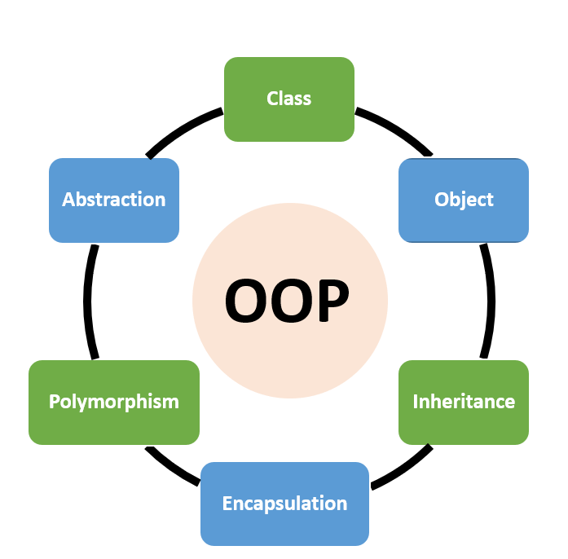
Polymorphism, Encapsulation and Data Abstraction
Presented By:
Name: Shyamashree Ghorai
ID : STB03006
Education: B.Sc. in Mathematics
from Calcutta university ,M.Sc. in Data Science
from Maulana Abul Kalam Azad University of Technology
Associated with Scifor Technologies

Slide 2
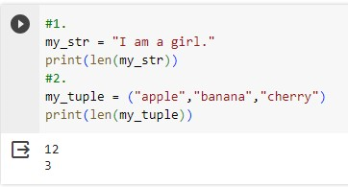
Polymorphism
Polymorphism is taken from the Greek words Poly(many) and morphism(forms).
In programming, it refers to methods/functions/operators with the same name that can be executed on many objects or classes.
Function polymorphism : An example of python function is the len() function that can be used
on different objects.

Slide 3
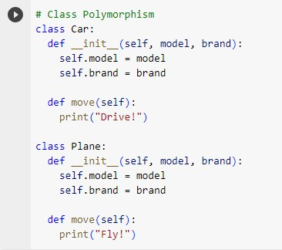
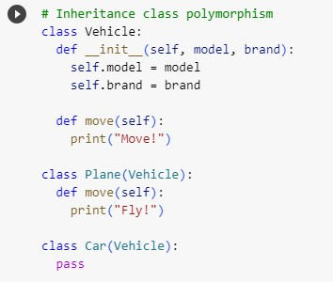
Class polymorphism : Polymorphism is often used in Class methods, where we can have multiple
classes with the same method name. For example, we have two classes: Car , Plane and they
all have same method called move():
Inheritance class polymorphism: In python, polymorphism lets us define methods in the child class that have the same name as the methods in the parent class.

Slide 4
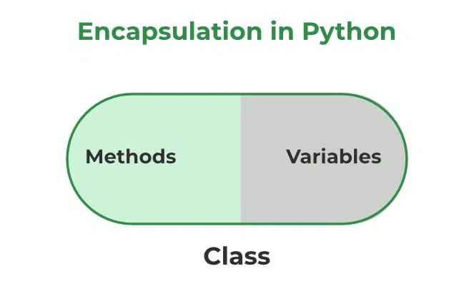
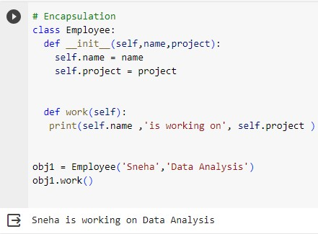
Encapsulation
Encapsulation is one of the fundamental concepts in object-oriented
programming.
It describes the idea of wrapping data and the methods that work on data
within one unit.
This puts restrictions on accessing the variables and methods directly and can prevent the accidental modification of data.
A class is an example of encapsulation as it encapsulate all the data that is member function,
variables, etc.

Slide 5
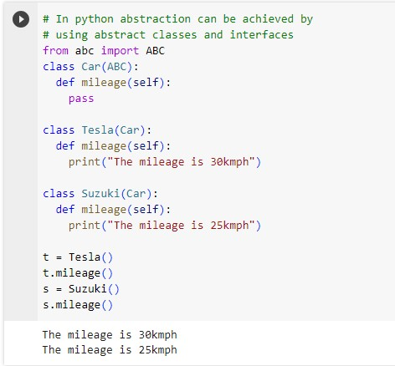
Data Abstraction
Data abstraction is one of the most essential concepts in python OOPs which is used to hide the
irrelevant information from the user and show the information that are relevant to the users.
In case of television remote, for example. The buttons tell us how to increase or decrease the
volume and power the television on and off, and these commands are relevant to us.
Importance of data abstraction: This abstraction makes it easier to understand and maintain well-organized code and improves developer collaboration.

Slide 6
THANK YOU

